Slide 1


Note: Sharing or editing the video/audio using any software or website is strongly prohibited

Slide 2
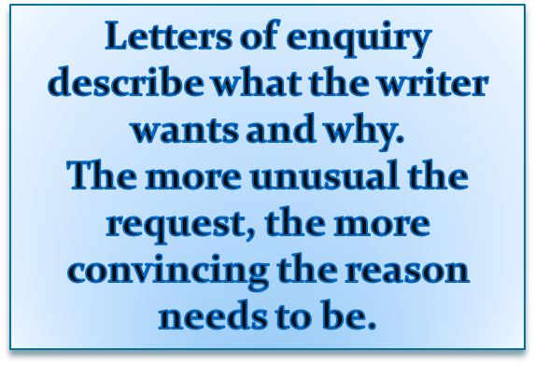

The purpose of this form is to obtain information from the reader. If the reader is expecting the letter, the writer’s task is easy.
If the reader is not expecting your letter, then it is more difficult. In this case, following these four guidelines will be helpful:
  State your purpose
  List your questions or requested action
  Offer something in return to encourage action
  Follow up with a thank you note, e-mail, or phone call to the person who helped you with your request

Slide 3
TYPES
Letter of inquiry requesting information
Letter of inquiry providing information as a reply
Letter of inquiry about refusal

Slide 4

A.Q.Electronics Ltd.
Calle Estoril 1701
Barselona
Ref: JR/ct
Standart Office Furniture Ltd.
Cantley Rd.
London, SW4 9HX
Great Britain 12 Oct., 1998
Dear Sirs,
We have read an article in “Office News” about your range of visible record system filing cabinets. We are interested in introducing a modern filing system in our main office. We also wish to install an electronic system for the storage and retrieval of data.
Please send us price list and catalogues of your manual and electronic data processing systems, quoting your price f.o.b. London if possible. We are particularly interested in type TW37, so we would be grateful if you would enclose more detailed information about this particular model.
We look forward to hearing from you soon.
Yours faithfully,
J. Rodriguez,
Office Manager

Slide 5




This should inform the reader that this is an enquiry or request
Enquiry about Textbooks
Request for Brochure
Query about Website
Question regarding Product Components
EXAMPLE

Slide 6

This should tell the reader what you want
The introduction includes your purpose of writing the letter, any queries or questions you want answers for or any request

Slide 7


Please send me...
Could you please send me...
(for things that the organization offers to send)
I would be grateful if you could tell me…
(for things that are not normally offered)
I am writing to enquire whether…
I would be grateful if you could…
(to see if something is possible)
I would especially like to know…
Could you send me more details…
( + a more detailed request)
Could you also…
I would also like to know...
Could you tell me whether...
( + an additional enquiry or request)
EXAMPLE

Slide 8

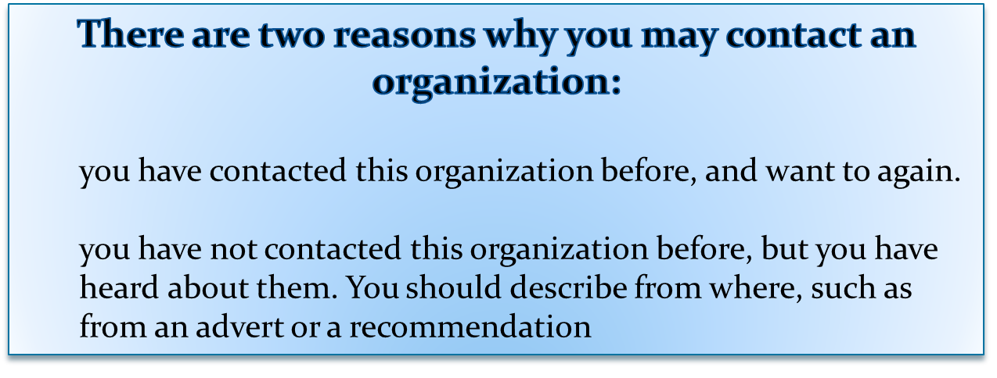
This paragraph tells the reader why you are contacting his or her organization, and gives further details of the enquiry

Slide 9
EXAMPLE
I saw your advert in the HK Daily on Wednesday, 13 June 2007.
Your company was recommended to me by Ms. Elsie Wong of Far Eastern Logistics.
With reference to your advertisement (ad) in...
Regarding your advertisement (ad) in ...

Slide 10


This paragraph should contain a polite expression and/or an expression of thanks to the reader. The degree of politeness (and therefore the length), depends on how unusual or difficult your request is. Possible language includes:
  Thanks. (For a very informal and normal enquiry or request)
  I look forward to hearing from you.
  I am looking forward to hearing from you.
  Thank you for your assistance.
  Thank you very much for your kind assistance.
  I appreciate that this is an unusual request, but I would be very grateful for any help you could provide. I look forward to hearing from you.
If you think the reader might have further questions, you can suggest that he or she contact you.

Slide 11

__________Better Widget Makers, Inc.__________
5555 Widget Avenue
Silver City, CO 80456
September 26, 2003
Mr. Russ Hamilton
Vice President, Sales and Marketing
Golden Bread Company
123 Loaf Street
Silver City, CO 80451
Dear Mr. Hamilton:
Construction on the new employee cafeteria at Better Widget Makers, Inc. is nearing
completion and I am looking for a supplier capable of fulfilling our weekly bakery needs.
Do you have an information packet that would help me project the cost of doing business
with your company? We will need daily deliveries of pastries, pies, dinner rolls and
sandwich bread. Our facility operates 24/7, Monday through Friday, with a flextime
workforce of 1,500 employees. To complete my operational budget I will need the
following information:
      • Wholesale price sheets
      • Quantity cost breaks
      • Annual contract discounts
      • Delivery and or any other service charges.
To submit my proposal to the finance committee at their October 20th meeting I will need
to receive your information by the 10th. I will also need to meet with you after reviewing
the requested materials. Please call me for an appointment at your earliest convenience.
My personal extension is 216-8080, # 29.
In keeping with long-standing policy we would like to place this contract locally. I look
forward to working with you and am hopeful that the Golden Bread Company can fulfill
our needs.
Sincerely,
Ida Mae Knott
Purchasing Agent

Slide 12



Acknowledging receipt of an enquiry/request
Thank you for your letter of … regarding / concerning / in connection with …
I refer to your enquiry about / relating to…
I have received your letter of… requesting information about …
We would like to thank you for enquiring about ...
Explaining action taken as a consequence of the enquiry
I have (reviewed our available stock) …
We held a meeting on 21 January to discuss possible solutions.
I have checked/looked into/investigated (the possible approaches) …

Slide 13


The best choice would be … since …
I highly recommend … as / due to the fact that …
…would probably be more suitable because…
… seems to suit you better although …
Perhaps you should choose … even though…
I suggest that you (should) choose …
I recommend this item since …
In view of the fact that …, I would strongly recommend … as …
Making suggestions / justifying recommendations / pointing out pros and cons /

Slide 14



While I appreciate your firm’s need for this information, I regret that …
It will not be possible to … for legal reasons. We are bound to …
Your proposal is of interest to us, and we have had consultations about it.
However, we feel that it will not be in our interests to … for reasons of (privacy).
We are concerned that …
Apologizing and rejecting proposals
Stipulating action requested or to be taken
We shall arrange for … by …at the latest.
I shall see to it that …
Our company will arrange for …

Slide 15


I hope this suggestion/information will be useful to you.
I hope this information will prove useful to you.
I hope that this information will help you to make decisions on your order.
I look forward to hearing from you.
I look forward to receiving your confirmation of …
I look forward to doing business with your company in the future …
Please feel free to contact me again if you have any further queries on …
Do contact me on 27615432 if you need further information.
Please do not hesitate to contact me on 27615432 if I can be of further assistance.
Establishing goodwill and suggesting contact

Slide 16


Everlong Batteries 171, Choi Hung Road Hung Hom, Hong Kong Tel/Fax 2235 2449 18 Jun 2007 Mr J Wong Purchasing Officer Fortune Goods 317 Orchard Road Singapore Dear Mr Wong Enquiry about Batteries Thank you for your letter of Thursday, 14 June 2007 regarding making copies of the sample battery you sent us. I have investigated the situation and found that your specifications are exactly the same as the design of a proprietary camera battery manufactured by a large Japanese electronics company. We feel that it would not be in our interests to supply this type of battery. However, I would like to thank you for considering our company as your supplier. I look forward to doing business with your company in the future Yours sincerely David Choi David Choi Distributions Manager
Notice these sentences in which the writer thanks his correspondent for an inquiry: Pay attention that we “inquire” about general information, and “request” an object or a statement.

Slide 17
__________Better Widget Makers, Inc.__________
5555 Widget Avenue
Silver City, CO 80456
September 26, 2003
Mr. Russ Hamilton
Vice President, Sales and Marketing
Golden Bread Company
123 Loaf Street
Silver City, CO 80451
Dear Mr. Hamilton:
Construction on the new employee cafeteria at Better Widget Makers, Inc. is nearing
completion and I am looking for a supplier capable of fulfilling our weekly bakery needs.
Do you have an information packet that would help me project the cost of doing business
with your company? We will need daily deliveries of pastries, pies, dinner rolls and
sandwich bread. Our facility operates 24/7, Monday through Friday, with a flextime
workforce of 1,500 employees. To complete my operational budget I will need the
following information:
      • Wholesale price sheets
      • Quantity cost breaks
      • Annual contract discounts
      • Delivery and or any other service charges.
To submit my proposal to the finance committee at their October 20th meeting I will need
to receive your information by the 10th. I will also need to meet with you after reviewing
the requested materials. Please call me for an appointment at your earliest convenience.
My personal extension is 216-8080, # 29.
In keeping with long-standing policy we would like to place this contract locally. I look
forward to working with you and am hopeful that the Golden Bread Company can fulfill
our needs.
Sincerely,
Ida Mae Knott
Purchasing Agent

Slide 18


